Slide 1


Renovation of the Construction Guidance Manual & Resources
Overview
Presented by: Roy Sturgill roy.sturgill@uky.edu
Kentucky Transportation Cabinet
Kentucky Transportation Center

Slide 2
Renovation of the Construction Guidance Manual & Resources
Background
Current CGM Version 2009
Prior to that 1995
Intended to be continually updated…
Basis for the formatting
Chapters 100 to 1300
Information
Quantity—too much
Quality—improved but still dated
Relevance—probably doesn’t do what we want
Kentucky Transportation Cabinet
Kentucky Transportation Center

Slide 3
Renovation of the Construction Guidance Manual & Resources
Opening Thoughts
What is guidance?
Help and advice about how to do something or about how to solve problems
Why does the website say Policy Manuals?
What do you need to administer the completion of a project?
Kentucky Transportation Cabinet
Kentucky Transportation Center

Slide 4
Renovation of the Construction Guidance Manual & Resources
What do you need?
Proposal & Plans
Spec Book
Standard Drawings
Supplemental Specs
Materials Sampling Manual/Checklist
Kentucky Methods
Geotechnical Report
Employee Safety Manual
Precast/Prestressed Manual
Approved Aggregate Sources
Approved Contractors List
Approved Materials List
2011 Section Engineer’s Guide
Grade & Drain I and II
Asphalt Field Technician Guide
Work Zone Traffic Control Guide
Erosion Control & Prevention Guide
Contacts List
~A lot of resources for a single cab pick-up…
Kentucky Transportation Cabinet
Kentucky Transportation Center

Slide 5
Renovation of the Construction Guidance Manual & Resources
Objectives
A central source guide/training document to provide the “bread crumbs” of administering the project
Begin with the end user in mind!
Focus on the Engineer & the Inspector
Too many resources
Can’t combine so, provide the “crosswalk”
Usability
Volume base ~ Desk References & Field Guides
Checklists, flow charts, & organized bulleted information
Kentucky Transportation Cabinet
Kentucky Transportation Center

Slide 6
Renovation of the Construction Guidance Manual & Resources
Project Tasks
Resource Collection & Review
Review Processes, Conflicts,& Outdated Material
CGM Revision & Volume Development
Panel Review
Collection of Technical Tools
Documentation
~Delivery Goal: March 2016
Kentucky Transportation Cabinet
Kentucky Transportation Center

Slide 7
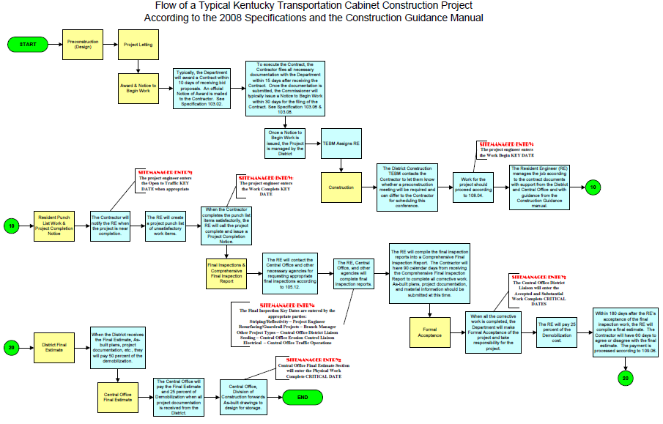
Renovation of the Construction Guidance Manual & Resources
What might the New CGM look like?
Desk References
Section Engineer Version
Processes should look like…
Pay Estimates
Change Orders
Claims
Project Closeout
General Documentation, etc.
Kentucky Transportation Cabinet
Kentucky Transportation Center

Slide 8
Renovation of the Construction Guidance Manual & Resources
Desk References Continued
Inspector Version
Project Notes & Documentation
Vehicle & Equipment
General Safety
Conduct
SiteManager Assistance
As-Built Plans
Project Closeout, etc.
Kentucky Transportation Cabinet
Kentucky Transportation Center

Slide 9
Renovation of the Construction Guidance Manual & Resources
Field Guides
Asphalt Paving/Resurfacing/Rehab
Concrete Pavement
Subgrade & Base Construction
Pipe & Drainage Structures
Erosion & Sediment Control
Lighting & Signals
Panel & Roadside Signs
Guardrail, Barriers, & Cable Barrier
Bridge Painting
Concrete Structures
Steel Structures
Safety, Traffic Control, & Accident Reporting
Miscellaneous Items
Curb & Gutter
Sidewalks
Kentucky Transportation Cabinet
Kentucky Transportation Center

Slide 10
Renovation of the Construction Guidance Manual & Resources
An Example Field Guide: Asphalt Paving
Project Prep Checklist
Pre-Pave Meeting Agenda
Project Layout
Inspection Points
Equipment & Paving Train Diagram
Checklist of Inspection Items
Discussion of process…leveling & wedging, tack coats, monitoring tonnage, etc.
Similar fashion to the current CGM
References to other sources…KY Methods, Specs, etc.
Kentucky Transportation Cabinet
Kentucky Transportation Center

Slide 11



Renovation of the Construction Guidance Manual & Resources
A final piece of the project…
A collection of technical tools
You know that cool spreadsheet you created…SHARE!
Kentucky Transportation Cabinet
Kentucky Transportation Center

Slide 12

Renovation of the Construction Guidance Manual & Resources
So, what am I asking you to do?
Review & edit current content
Provide comments & feedback
Volunteer to review
Share those spreadsheets or ideas
I NEED YOUR HELP!!!
Please contact me:
Phone: (859) 218-0119
Cell: (859) 312-6259
E-mail: roy.sturgill@uky.edu
Kentucky Transportation Cabinet
Kentucky Transportation Center

